Slide 1
Vulnerability Testing Approach
Prepared By: Phil Cheese
Nov 2008
Notes:
Security Specialist in Vodafone for the last 8 years
A long time ago I went to University and took Computer studies (It was actually a Polytechnic in those days but they are all universities now!)
South Bank Polytechnic – Computer Studies
Nationwide BS – Helpdesk Unix system adminstrator
IT Auditor
Vodafone

Slide 2
Outline
Structure of Technology UK Security Team
Why we test
What we test
When we test
How we test
Demo of a unix platform test
Hot topics
Questions and Answers

Slide 3

UK Technology Security teams
UK Tech. Security Mgr
Group CISO
Review New Systems
Security
Consultants
Vulnerability
Testing
Vulnerability Test Team
Security Monitoring
Mail, Logs, IDS, Firewall
Security Operations
Notes:
Consultants engage in projects and will define scope of VT testing
6 consultants
3 people work in VT team
6 security operations
Security Ops teams when they make firewall changes come across projects/changes not picked up by security consulatnts

Slide 4
Definition
Penetration testing v Vulnerability testing ?
Wikepedia
“Security testing techniques scour for vulnerabilities or security holes in applications. These vulnerabilities leave applications open to exploitation. Ideally, security testing is implemented throughout the entire software development life cycle (SDLC) so that vulnerabilities may be addressed in a timely and thorough manner. Unfortunately, testing is often conducted as anafterthought at the end of the development cycle.”
Why ? – test against standards, identify misconfigurations, old vunerable versions of software, test drive
Ethics & Legality
Notes:
Found this definition on the web – this is pretty close ro what I do
Question – how long does it take for an unprotected computer to get attacked on ?
Estimates vary from a few minutes on up as to how long it takes an unprotected computer to get infected. SANS, a security firm, shows a chart of the average time between attacks for its clients and recent times are 20-30 minutes
Hands up anyone that has heard of the term ‘penetration testing’ ! Ok do you know the difference between VT & PT ?
Talk some of code of conduct on testing – permission of system owners, if you start scanning systems it could be viewed as illegal by law enforecement agencies, breach of the t &c ‘s of your broadband connect – computer misuse act – Tsuami web site site Dan Cuthbert ../../../../

Slide 5
Why testing
Preventing financial loss through fraud (hackers, extortionists and disgruntled employees) or through lost revenue due to unreliable business systems and processes.
Proving due diligence and compliance to your industry regulators, customers and shareholders. Non-compliance can result in your organisation losing business, receiving heavy fines, gathering bad PR or ultimately failing. Protecting your brand by avoiding loss of consumer confidence and business reputation.
vulnerability testing helps shape information security strategy through identifying vulnerabilities and quantifying their impact and likelihood so that they can be managed proactively; budget can be allocated and corrective measures implemented.
Notes:
Financial loss – IC3 Internet Claims Centre £239M dollars 2007
Has anyone heard of Sarbanes Oxley – PCI-DSS ?

Slide 6
Defining the scope
Full-Scale vs. Targeted Testing
Platform, Network, Database, Applications
Remote vs. Local Testing
In-house v outsourcing
Notes:
Sweep the internal network – telephone directory – not reccomened, but mangement like the idea – targeted testing of new systems, scope out
Sit down with technical architects and whiteboard physical representation
Identify platforms, networks and database
Web application and Network testing can be done remotely – but Platform testing and database will require to be connected locally – so could involve arranging access to data centres, - not very glamourous, cold , noisy, in the middle of no-where – I’ve been to East Acton, Glasgow, Basingstoke
Internal, small team of 3 do some work, outsource specialist work i.e manual web app testing, wireless – loads if third parties do it, some ‘cowboys’ NGS, IDSEC and NCC – trying to regulate – CREST – expensive – 800-1500 per day – short assignments – project pay !

Slide 7
Defense in depth
Network
Operating System
Database
Application
Notes:
Onion layers
Vulnerability in one layer will compromise other layers – e.g. Oracle database TNS listener vulnerability
Or Blaster worm – August 2003 The self-replicating worm spread by exploiting a buffer overflow in the DCOM RPC service on the affected operating systems, for which a patch had been released one month earlier in MS03-026 and later in MS03-039 - i.e. operating system vulnerabilities – took out the network !
Micosoft patch Tuesday - MS08-067 – out of band patch
Anyone heard of SQL injection? Through the http layer control of compromise the backedn database

Slide 8



www.vodafone.co.uk
Tester
Nmap
Nessus
Network elements e.g SGSN’s, HLR’s
Sun Solaris
Application Server
HP-UX
Oracle DB
Redhat
Apache Web server
Windows File server

Slide 9
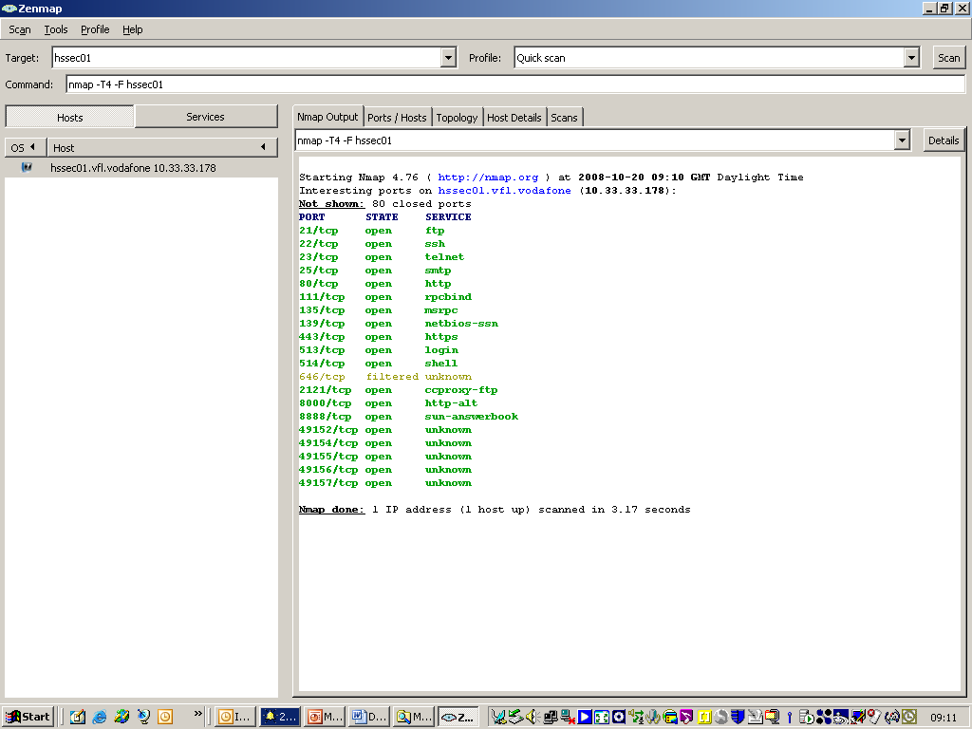
Nmap

Slide 10
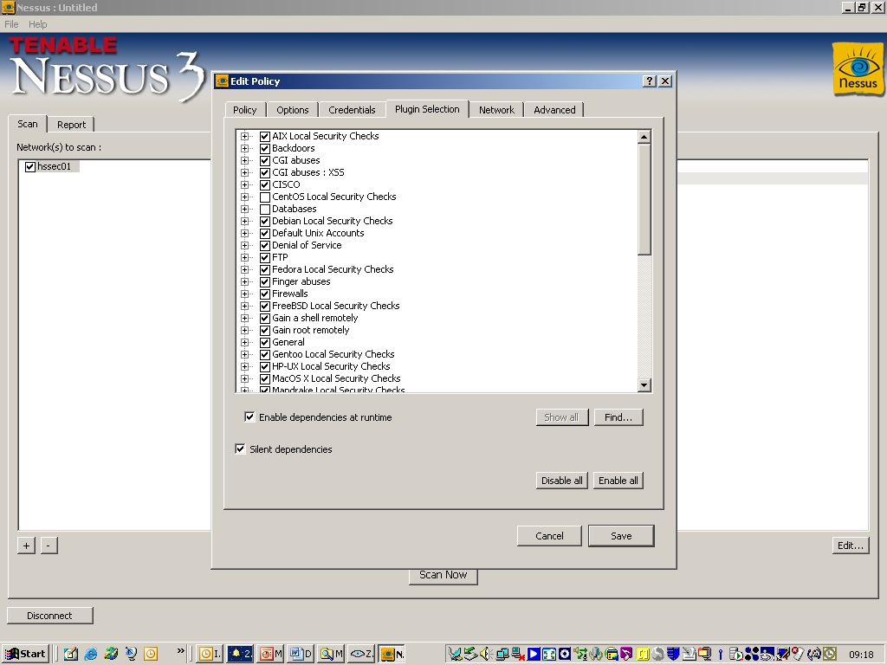
Nessus

Slide 11
www.vodafone.co.uk
Tester
Network elements e.g SGSN’s, HLR’s
Assuria
Agents
Sun Solaris
Application Server
HP-UX
Oracle DB
Redhat
Apache Web server
Windows File server

Slide 12
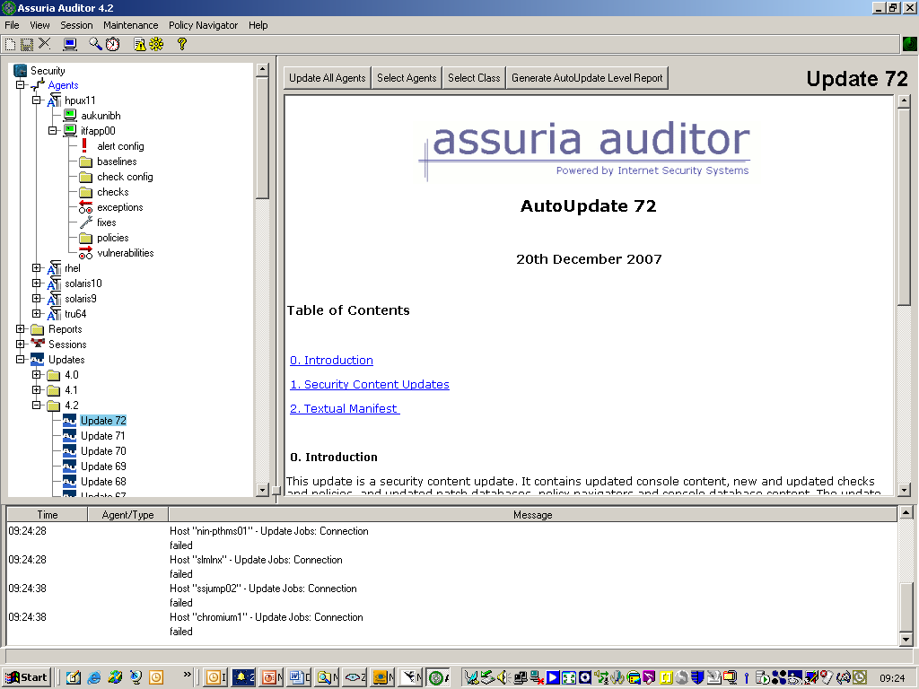
Assuria Auditor Console

Slide 13
www.vodafone.co.uk
Tester
NGS Squirrel
Network elements e.g SGSN’s, HLR’s
Sun Solaris
Application Server
HP-UX
Oracle DB
Redhat
Apache Web server
Windows File server

Slide 14
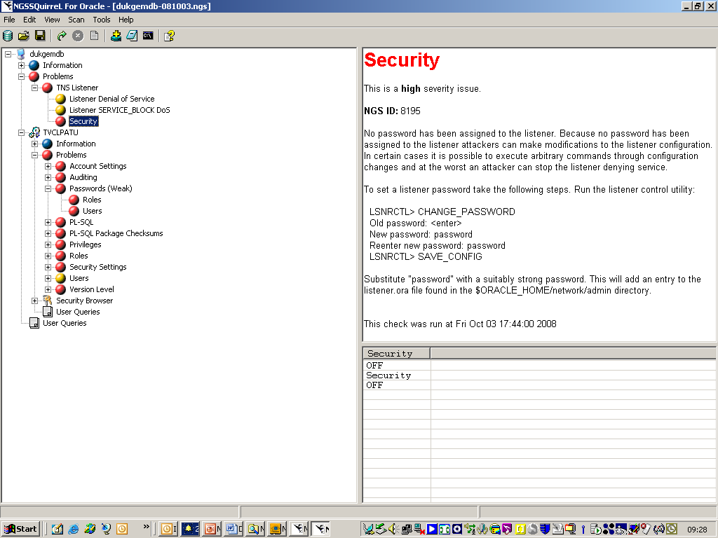
NGS Squirrel

Slide 15
Appscan, Superwalk
www.vodafone.co.uk
Tester
Network elements e.g SGSN’s, HLR’s
Sun Solaris
Application Server
HP-UX
Oracle DB
Redhat
Apache Web server
Windows File server

Slide 16
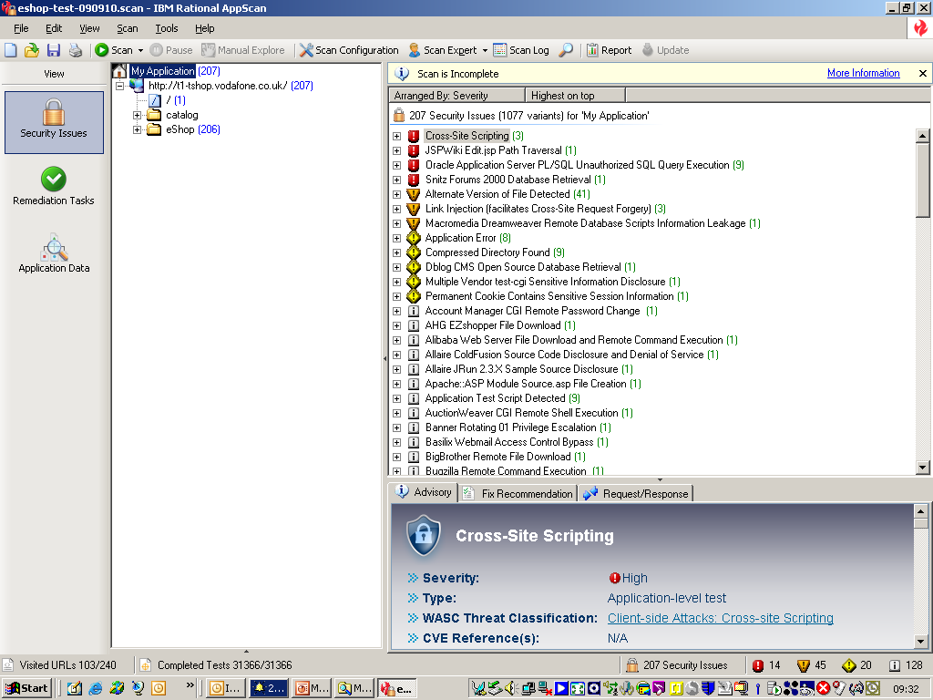
Appscan

Slide 17
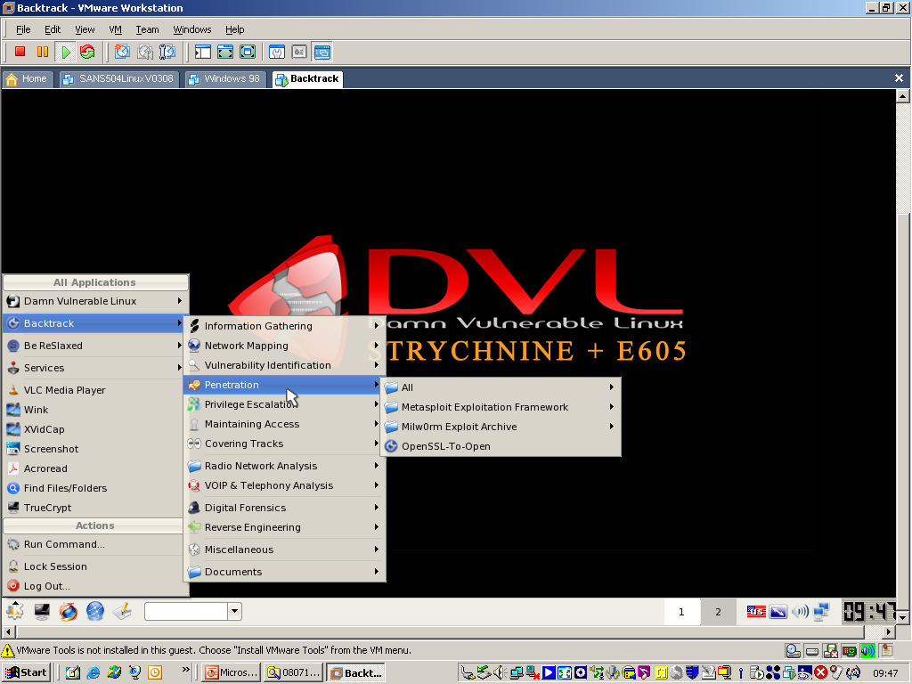
Backtrack

Slide 18
www.vodafone.co.uk
Tester
Network elements e.g SGSN’s, HLR’s
Sun Solaris
Application Server
HP-UX
Oracle DB
Redhat
Apache Web server
Windows File server
Assuria CLI Remote test (Data Centre)

Slide 19
Remote platform vulnerability assessment using Assuria Auditor & workbench via the command line
“It is better to voyage hopefully than to drive to Oldham”
FTP and install scripts
Run scans
Copy off raw results files
Generate csv files
Import results into workbench
Review scan results
Producing reports
Agreeing remedial actions and re-testing

Slide 20
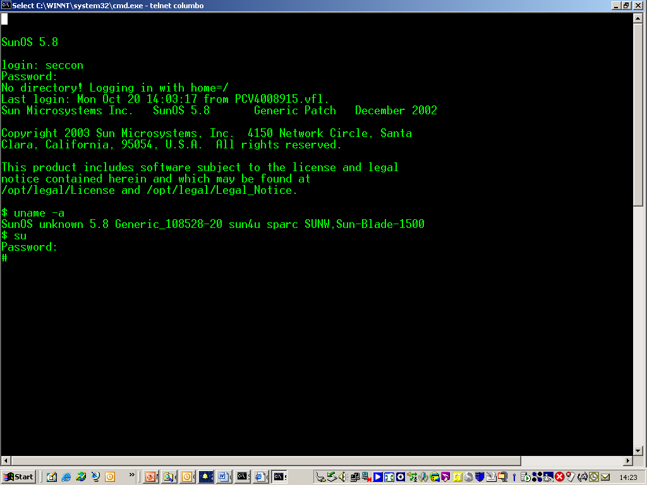
Log onto remote server

Slide 21
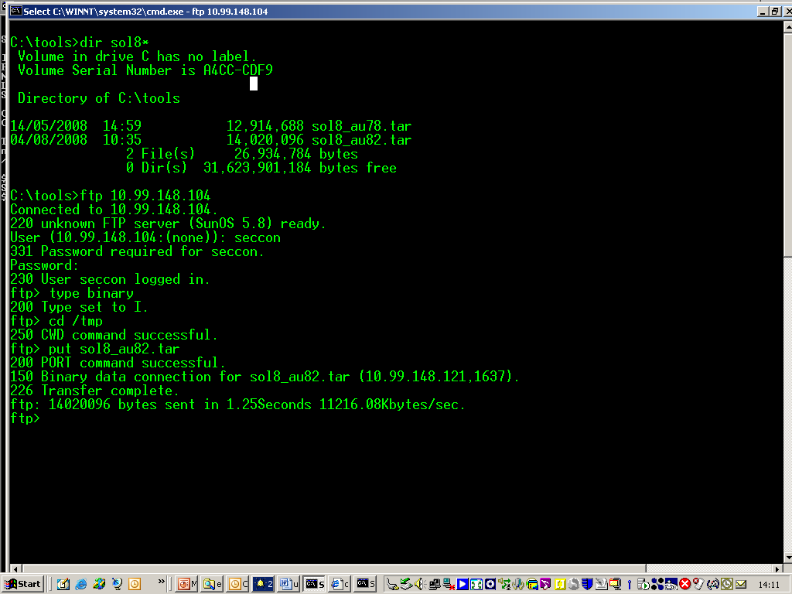
FTP onto a remote server

Slide 22
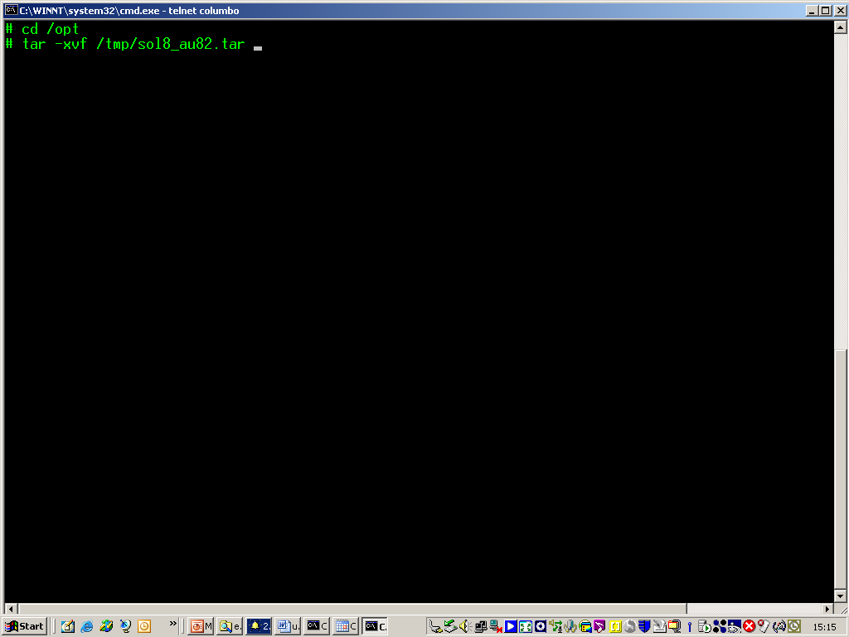
unzip tarball file

Slide 23
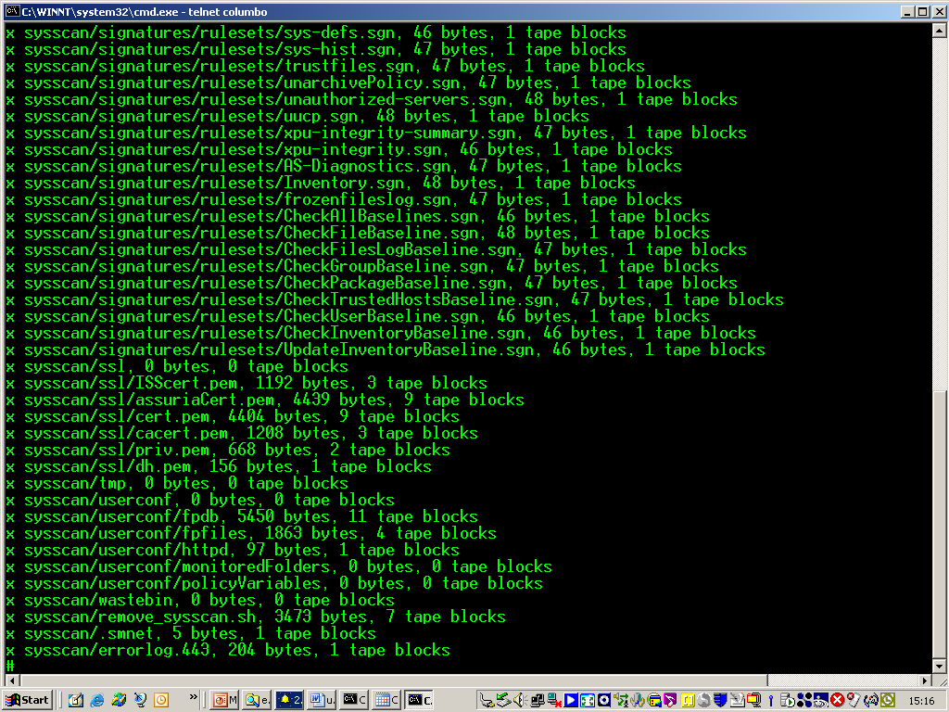

Slide 24
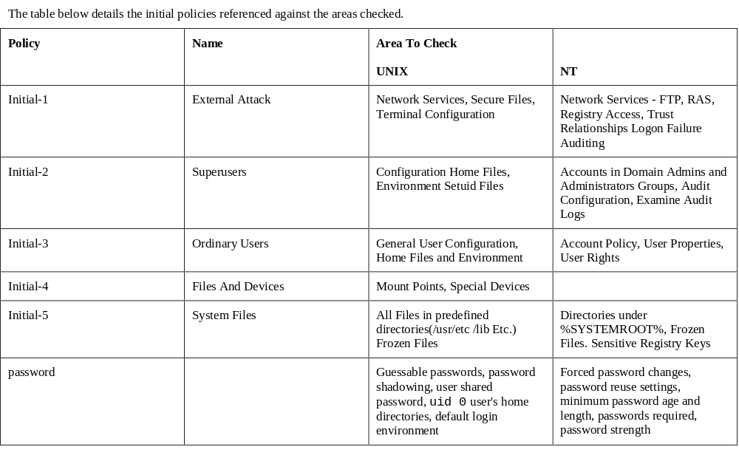
Areas checked by ‘Initial’ policies

Slide 25
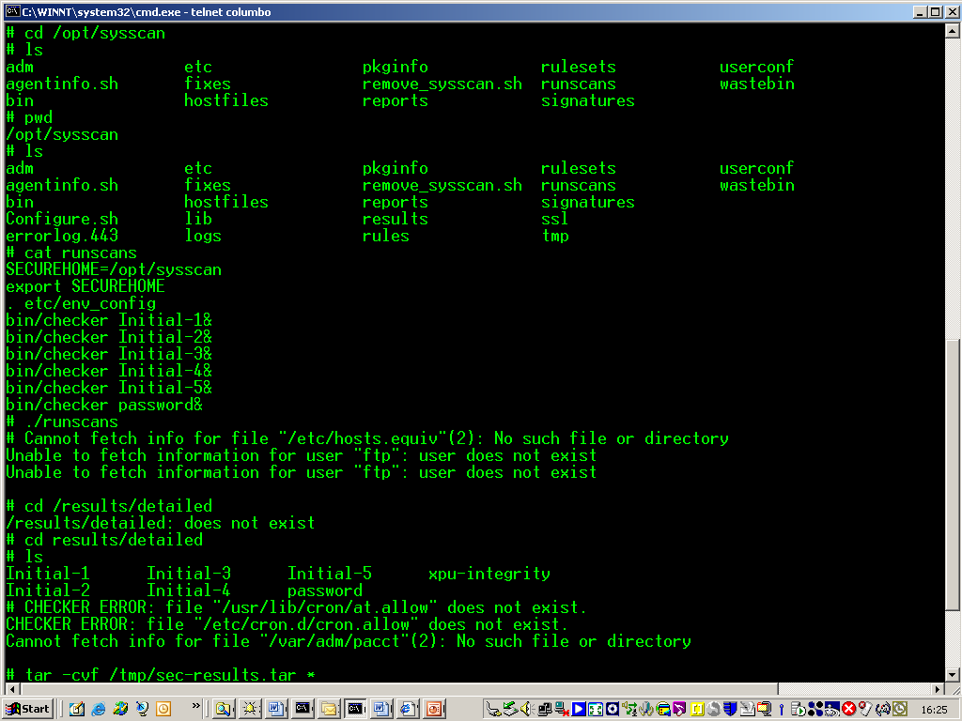
Run scans

Slide 26
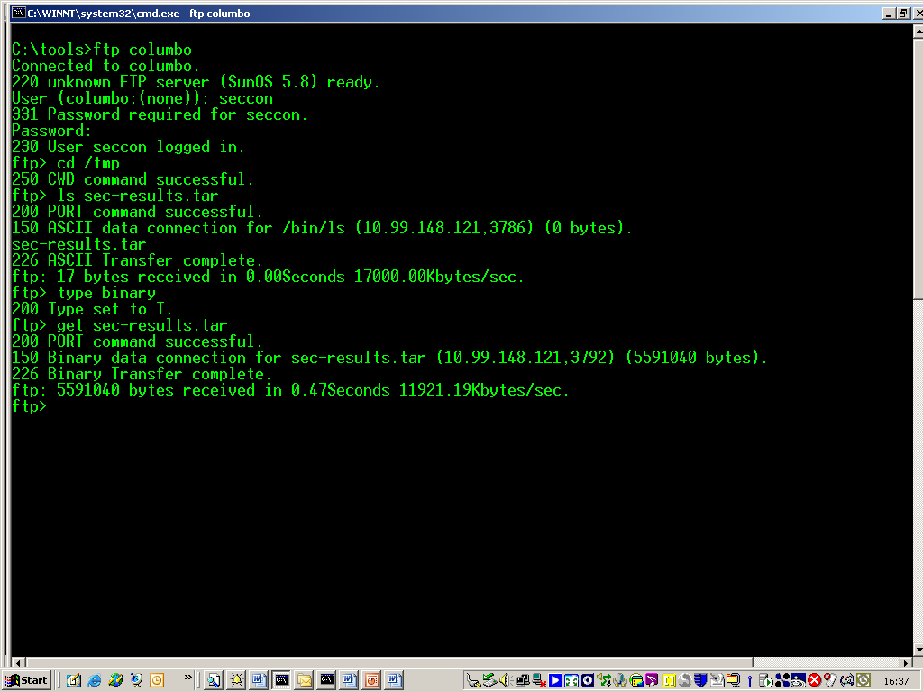
FTP results back to desktop

Slide 27
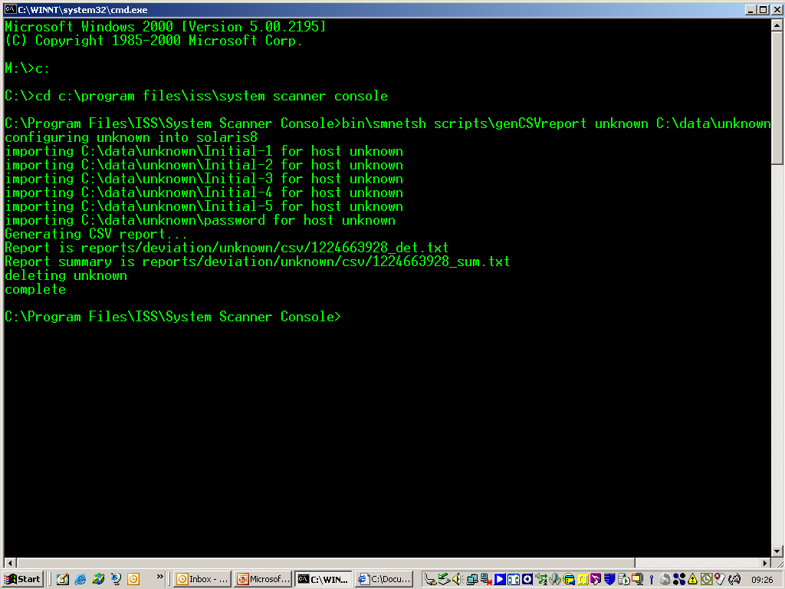
Generate CSV files

Slide 28
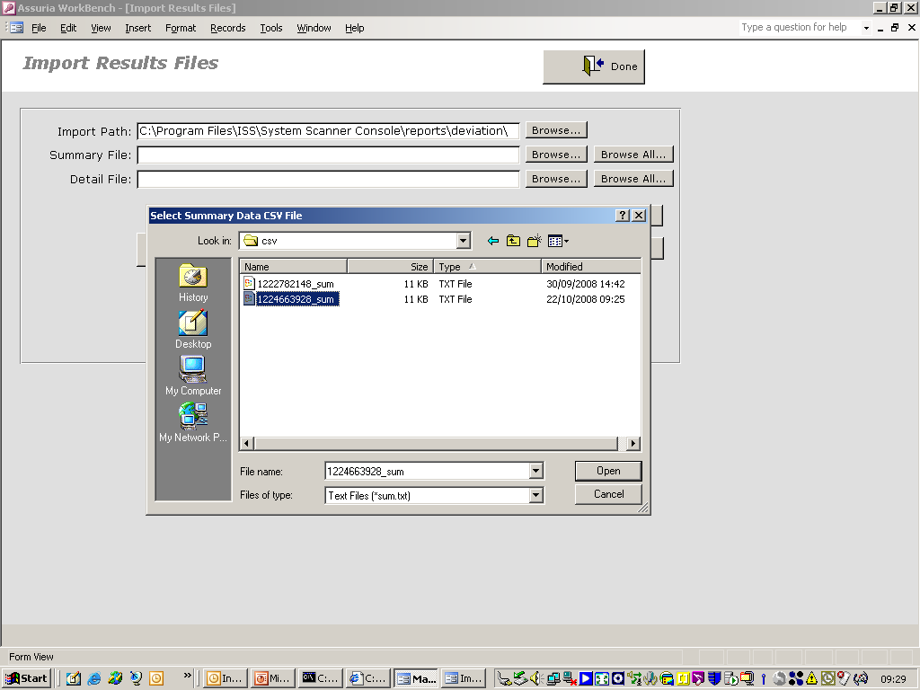
Import into Workbench

Slide 29
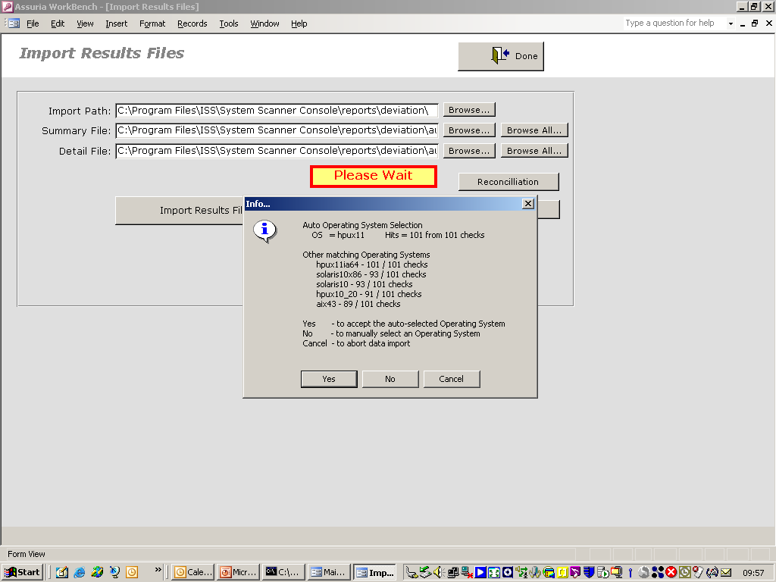
Reconcile results

Slide 30
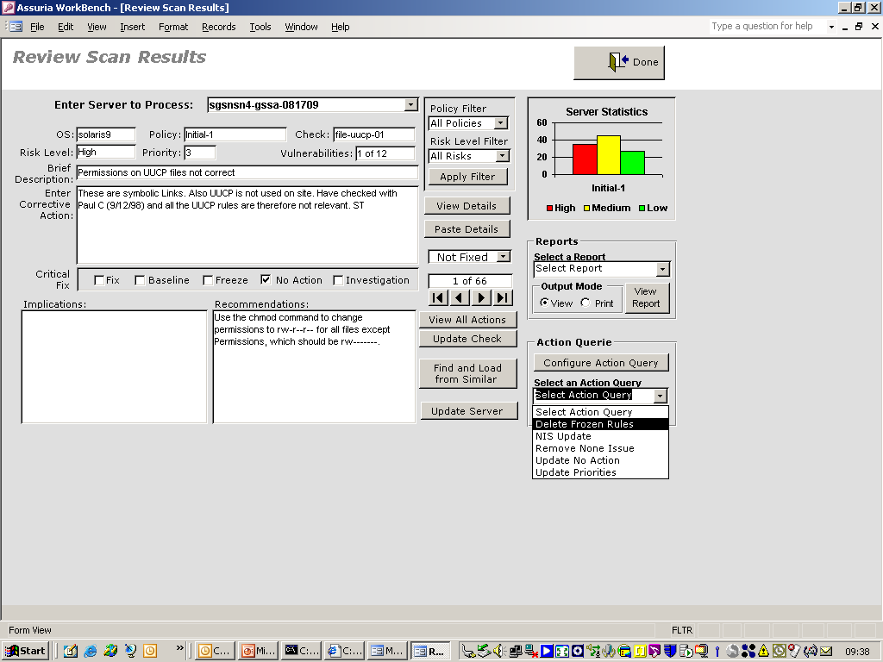
Filter results

Slide 31
Vulnerability testing - hot topics
PCI-DSS – keeping Security vendor industry going!
https://www.pcisecuritystandards.org/
Appliances and automation – keep your auditors happy
http://www.qualys.com/products/qg_suite/
http://www.ncircle.com/index.php?s=products
Virtualisation and middleware vulnerabilities – don’t forget’em….
http://labs.mwrinfosecurity.com/
Exploitation tools – Metasploit framework, Canvas, Core Impact. BEEF
http://www.metasploit.com/
http://www.immunitysec.com/
http://www.coresecurity.com/
http://www.bindshell.net/tools/beef
Notes:
12, Requirements, Requirement 11: Regularly test security systems and processes

Slide 32
Conclusions
In depth, holistic approach to security testing
Testing needs to take place during the development lifecycle
Can be complex and time consuming
Outsource specialist testing to third party vendors
Commercial tools easy to maintain and use but can be expensive
“A fool with a tool is still a fool”
Results from tools need analysis and put into a ‘business risk’ context

Slide 33

Any Questions ?

